Slide 1
Making the Most out of Gmail
Capital District of Key Club International Communications Committee

Slide 2
Utilizing “Tabs”

Slide 3
Cluttered Inbox?
The “tabs” feature helps to sort out emails based on the sender and with recognition of recipients.
There are categories provided, but you can also customize how you want certain emails organized - based on the sender.

Slide 4
Categories of Tabs

Slide 5
The Benefits
Organize and declutter your inbox
Centralize your emails

Slide 6
Utilizing “Contacts”

Slide 7
Ever gotten this notification?
This occurs because Gmail believes you’re sending spam in your mass emails. (ex. Newsletters)
This can be avoided by using the “Contacts” feature, and adding all of your recipients.

Slide 8
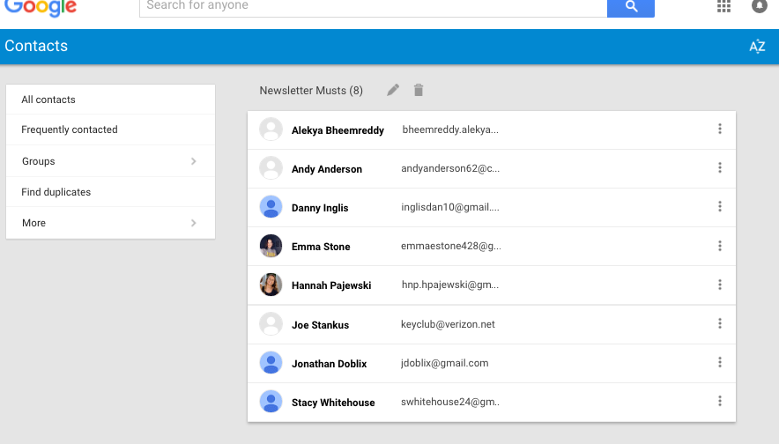
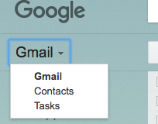
Navigating
This is how you get there
This is what it should look like

Slide 9
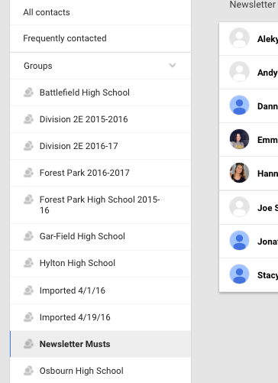
Once there…
You can import/export contacts through the “More” section at the bottom of the page.
The “Groups” feature is the most handy:
Divide your contacts by
Schools
Division
District Board
Committee
etc.

Slide 10
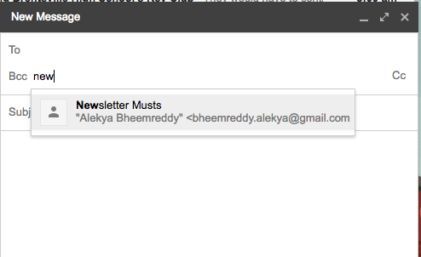
The Benefits
Acts as a shortcut when typing recipients
Never forget to send to certain people
Since they’re in your contacts, the messages won’t bounce back
Organization
Easy to compile & share at the end of the year

Slide 11
Utilizing “Tasks”
Easily compile and organize your responsibilities in a convenient location.

Slide 12
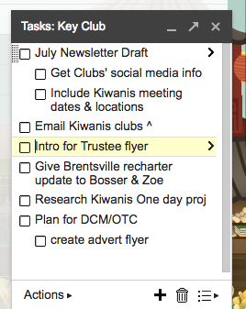
How to use
Minimalize easily
Easily indent for more organization

Slide 13
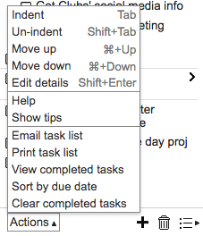
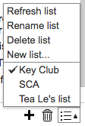
How to use
The ‘list’ feature helps to categorize different responsibilities
Use the ‘actions’ tab for extra details

Slide 14
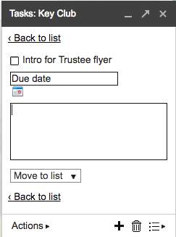
How to use
Customize by adding dates & details

Slide 15
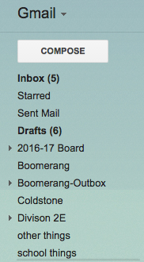
Utilizing “labels”
This feature is a great way to file and organize your emails.

Slide 16
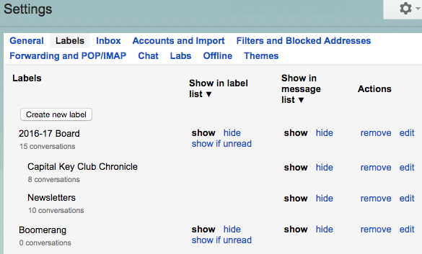
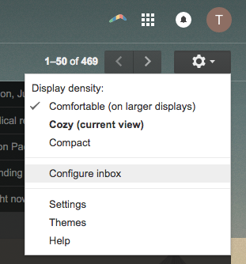
How to use
Here you can customize the labels that appear in your inbox. Handy features include nesting and ‘show if unread’ .
How to access and edit labels.

Slide 17
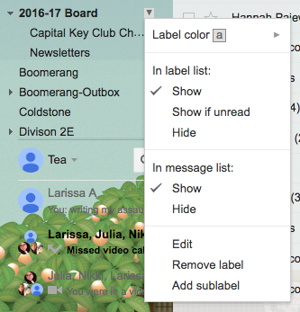
How to use
You can also edit existing labels right in your inbox. I’ve highlighted some nifty features!

Slide 18
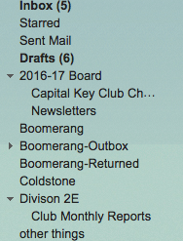
Handy Features
You can also nest sub labels for further organization!
Here are examples of useful labels. Also note, I customized my “main” labels so I only have what I really use.

Slide 19
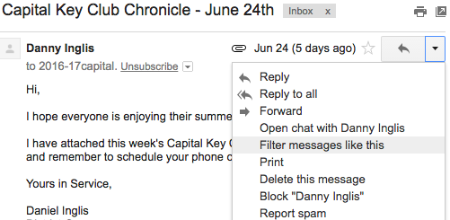
Utilizing Filters
Filters help to categorize certain emails so they’re easier to find, right when they get to your inbox!
They also can be applied so certain filtered messages are automatically put under certain labels!

Slide 20
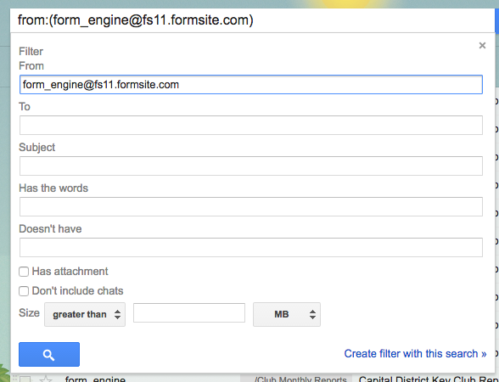
How to use
From here you can customize exactly how you want to ‘filter’ your messages
There are many options to choose from!

Slide 21
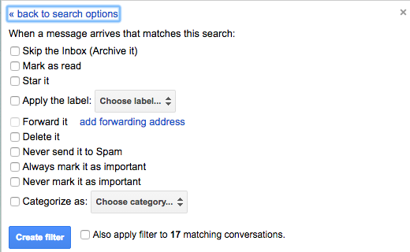
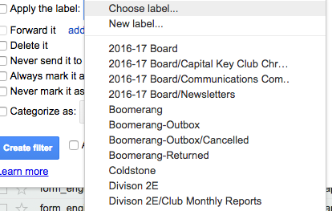
How to use
After choosing what you want to filter, from here you can choose what happens/how it is filtered.
You can go even further and choose exactly how it’s organized within your system.

Slide 22
The Benefits of Labels and Filters
Declutter your inbox
Organization
Easily find emails you need
Customize to suit you

Slide 23
Utilizing Boomerang
A free downloadable Gmail extension

Slide 24
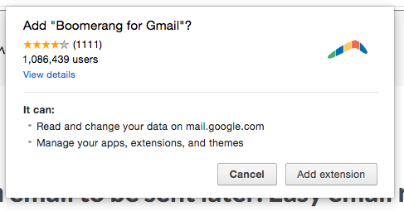
How to Download
Boomerang is only available on Google Chrome, Safari, and Firefox.
If you have any of those,
Go to “ http://www.boomeranggmail.com/ “
Click the big red button
And get started!

Slide 25
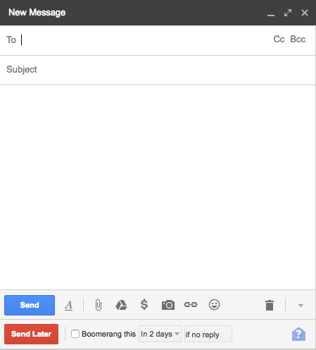
How to use
Once you’ve successfully gotten the extension, this new area will appear when you compose a message

Slide 26
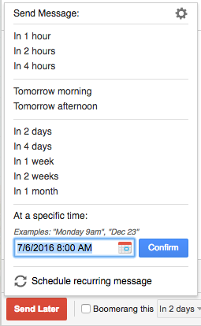
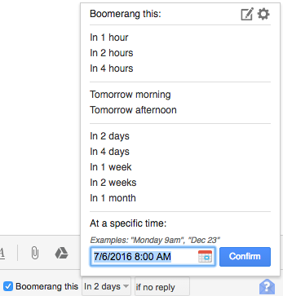
How to use
Tip: Both of these options are accessible once you’ve clicked on the portions highlighted.
With this feature you can choose for your message to be bounced back to you if it doesn’t receive a certain response.
This feature is extremely useful - it allows you to schedule when you’d like to send out your emails so you can prepare them in advance.

Slide 27
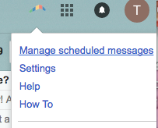
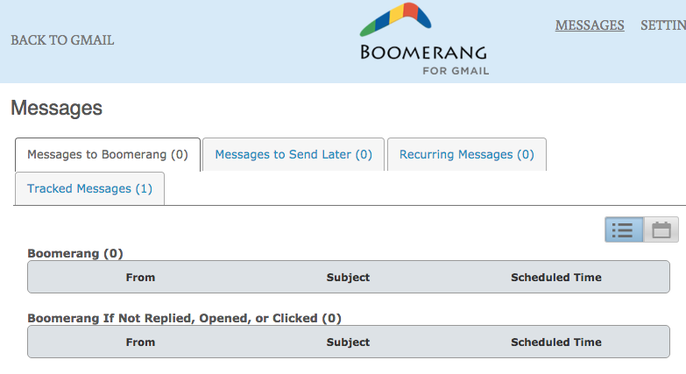
How to use
You can manage all of your messages here.
This dock allows you to see the details of all the messages you send using a boomerang feature.

Slide 28
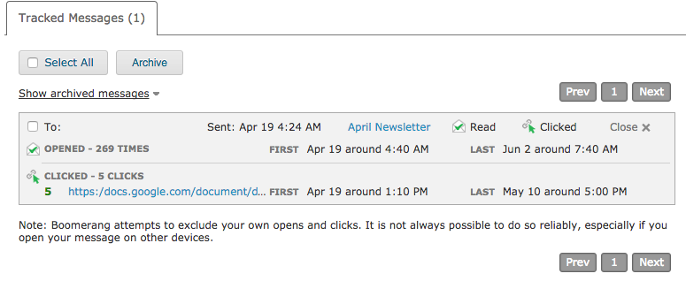
Features
For example, when you don’t get any replies, you can use this to at least check interaction with the email.

Slide 29
The Benefits
Write emails ahead of time
Schedule emails to be sent out at any time
Track recipient interaction

Slide 30
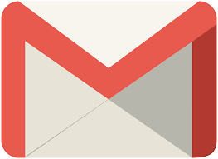
Have fun exploring all the ways to maximize your Gmail use!

